Slide 1



Attitude measurements based on direct solar irradiance vector
Student: Collin Krawczyk
Mentor: Michael Shafer – Assistant Professor of Mechanical Engineering

Slide 2
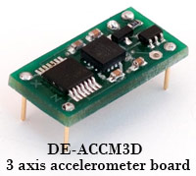
Background
Accelerometer
  Device that measures orientation
  Used in all devices
Accelerometer Problem
  Erratic Motions
  Reference Frames
Figure 1: Accelerometer [1]

Slide 3
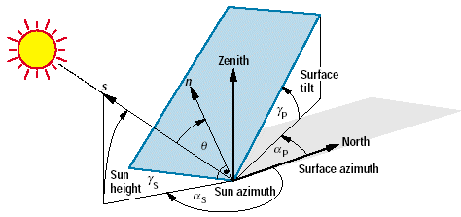
Objectives
Solar Panels
Solar Vectors
  Sun Azimuth
    Horizontal angle from North to sun position
  Elevation Angle
    Vertical angle to the Sun from horizontal
  Surface Tilt
    Vertical angle to the panel from horizontal
Latitude and Longitude
  Known GPS coordinates can determine location of the sun
Earth based system
Figure 2: Sun angles [2]

Slide 4
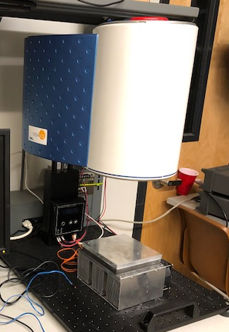
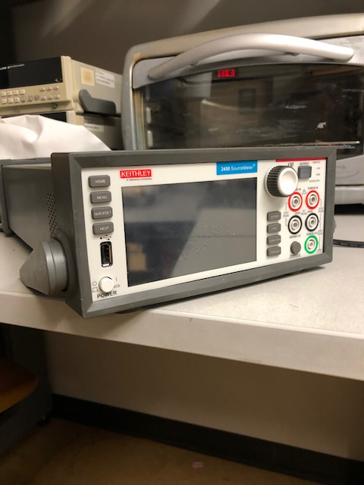
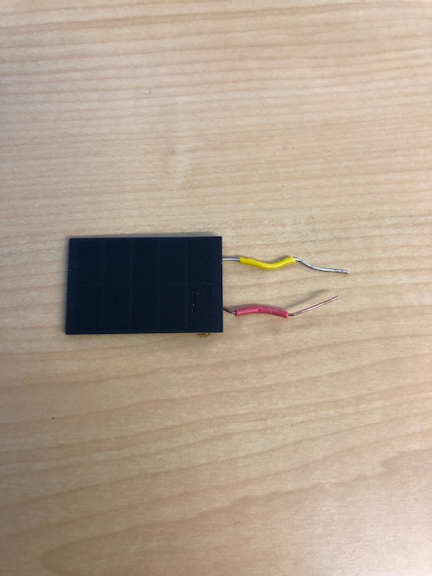
Equipment Used
Artificial Sun and Source Meter
  Located in dynamic and active systems lab (DASL)
Solar Panels
  Found within the DASL lab
3D Printed Solar Panel Design
  From past capstone
Figure 5: Artificial Sun
Figure 3: Solar Panel
Figure 4:Keithley Source Meter

Slide 5
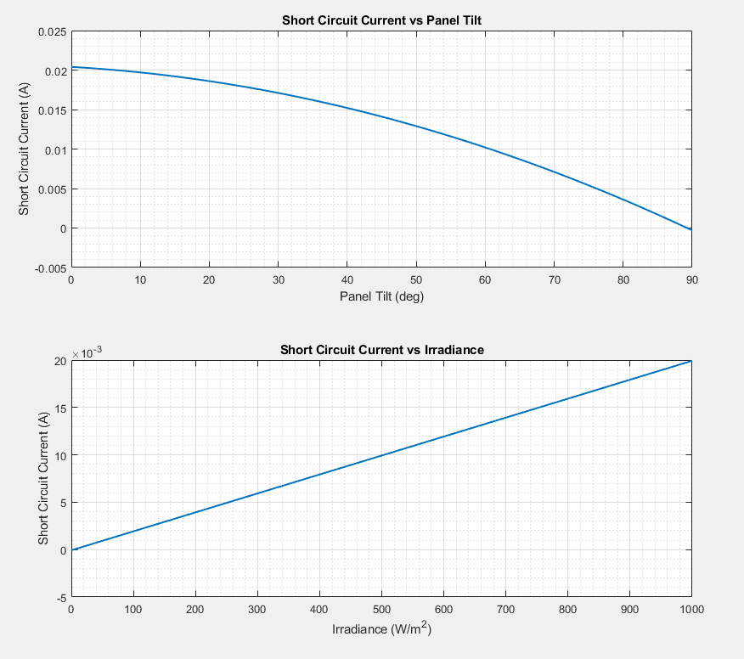
Solar Panel Characterization
Irradiation
  Energy that is hitting the panel
Run trials to determine current
  With fixed irradiance
  With fixed panel tilt
Figure 6: Solar Panel Characterization

Slide 6
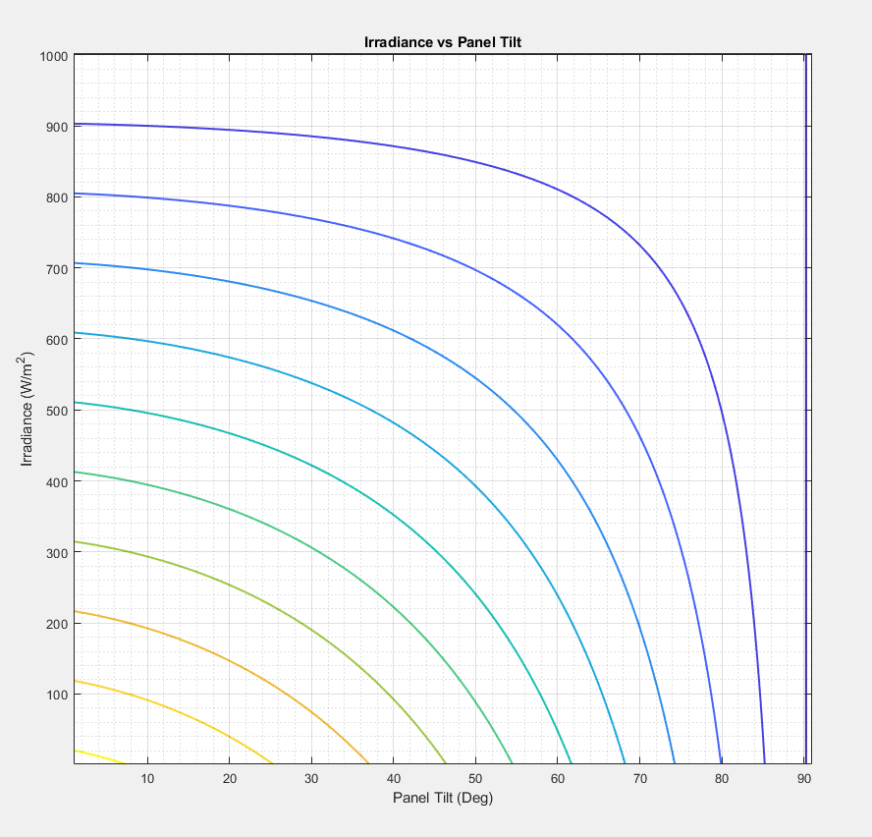
Tabulated Current
Combination of past 2 graphs
Allows for searching of currents
Figure 7: Current Table

Slide 7
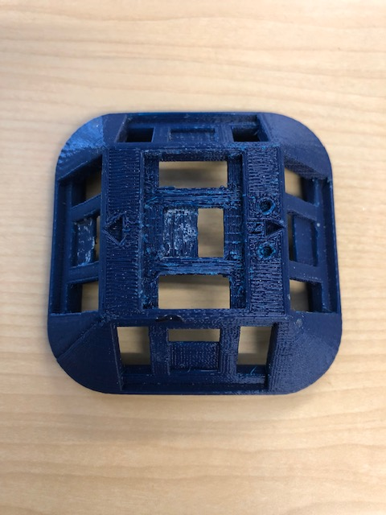
Results
Possible to get angles of panels for 2D
Outside testing
  Current inputs corresponding to irradiance
  Narrow down panel tilts
    Irradiance values given by location
Figure 8: Example panel tilts given an irradiance
Figure 8: 3D printed solar panel device

Slide 8
Conclusion
Use of solar panels for applications in Earth based systems to obtain orientation
Applications
  Animals
  Electronics
  Vehicles
Future Work
  Three-Dimensional

Slide 9
Acknowledgements
NAU/NASA Space Grant
  Providing funds and this opportunity
Michael Shafer
  Providing mentorship, knowledge, and access to the DASL lab

Slide 10
References
[1] “A beginner's guide to accelerometers,” Dimension Engineering. [Online]. Available: https://www.dimensionengineering.com/info/accelerometers. [Accessed: 27-Feb-2019].
[2] V. Quaschning, “The Sun as an Energy Source,” Volker Quaschning. [Online]. Available: https://www.volker-quaschning.de/articles/fundamentals1/index.php. [Accessed: 27-Feb-2019].

